Slide 1


Tacdin OZMEN

Slide 2

Outline
Executive Summary
Introduction
Methodology
Results
Conclusion
Appendix

Slide 3
Executive Summary
Objective: Analyze factors affecting Falcon 9 first-stage landing and build a classifier to predict landing success.
Data: Combined SpaceX API and web-scraped dataset (N = 90, M = 17).
Key EDA Findings:
Landing success becomes more frequent in later flights (experience/time effect).
Landing success rate varies by orbit type, suggesting orbit is a strong predictor.
Model Result: Best model is Decision Tree (Train Accuracy = 0.87, Test Accuracy = 0.83).
Deliverables: EDA (visual + SQL), Folium map, Plotly Dash dashboard, and classification model.

Slide 4
Introduction
Background: First-stage landing is critical for reusability and cost reduction in Falcon 9 missions.
Problem Statement: Identify key factors that influence landing outcome and predict landing success (Class).
Key Questions:
How do launch site, orbit, and payload relate to landing success?
Does landing success improve over time?
What patterns can be validated using SQL analysis?
Which classification model performs best for predicting success?
Outputs: Visual EDA, SQL-based EDA, interactive map (Folium), dashboard (Plotly Dash), and a predictive model.

Slide 5

Section 1

Slide 6
Methodology
Executive Summary
Data collection methodology:
SpaceX REST API + web scraping to build the initial dataset.
Perform data wrangling
Cleaning, type conversion, handling missing values, and creating the target label (Class)
EDA: Visual exploration and SQL queries to identify patterns and key relationships.
Interactive Analytics: Folium map for launch sites and Plotly Dash dashboard for filtering and visual analysis.
Perform predictive analysis using classification models
Train/test split, feature preprocessing, and classification modeling to predict landing success.

Slide 7
Data Collection
Sources: SpaceX REST API and Wikipedia (web scraping).
API Data: Retrieved launch records (e.g., flight number, launch site, orbit, payload, landing outcome).
Scraping Data: Extracted additional launch table information from Wikipedia and merged with API data.
Output: Combined raw dataset prepared for cleaning and feature engineering.

Slide 8
Data Collection – SpaceX API
Pulled launch data using SpaceX REST API (JSON).
Main endpoint: /v4/launches (core launch records).
Enriched data via: /v4/rockets, /v4/launchpads, /v4/payloads (lookup by IDs).
Joined datasets to create the analysis table and derived the target Class label.
https://github.com/tcdn7/17-IBM-Test-Repo/blob/main/1-jupyter-labs-spacex-data-collection-api.ipynb
Start →
GET /v4/launches →
Select needed fields → GET /v4/rockets + GET /v4/launchpads + GET /v4/payloads → Merge by IDs
(rocket, launchpad, payloads) →
Create Class label →
Export dataset (CSV/DataFrame)

Slide 9
Data Collection - Scraping
Collected additional launch information using web scraping from Wikipedia tables.
Parsed the HTML table into a structured DataFrame (rows = launches, columns = attributes).
Cleaned and standardized column names and data types for merging with API data.
Output: a scraped dataset used to enrich the main launch table.
https://github.com/tcdn7/17-IBM-Test-Repo/blob/main/2-jupyter-labs-webscraping.ipynb
Start →
Open Wikipedia page (Falcon 9 launches table) →
Read HTML table → Parse rows/columns →
Clean (rename columns, remove symbols, convert types) → Create DataFrame →
Export scraped dataset

Slide 10
Data Wrangling
Start → Load API + Scraped datasets → Merge/Join tables → Select relevant features → Handle missing values → Convert data types → Create Class label → Final cleaned dataset (90×17)
Merged API and scraped datasets and selected the required features for analysis.
Cleaned the data (handled missing values, fixed data types, removed inconsistencies).
Created the target label Class (landing success/failure) for classification.
Output: final cleaned dataset (90 × 17) used for EDA and modeling.
https://github.com/tcdn7/17-IBM-Test-Repo/blob/main/3-labs-jupyter-spacex-Data%20wrangling.ipynb

Slide 11
EDA with Data Visualization
Performed exploratory analysis using scatter plots, bar charts, and line charts.
Visualized relationships between Flight Number, Payload Mass, Launch Site, and Orbit versus the landing outcome (Class).
Identified trends over time and differences in success rates across categories.
https://github.com/tcdn7/17-IBM-Test-Repo/blob/main/5-edadataviz.ipynb

Slide 12
EDA with SQL
Used SQL queries to validate EDA findings and summarize launch performance.
Queried launch sites, payload statistics, and landing outcomes (success vs failure).
Identified patterns such as highest payload missions, outcome counts, and time-based rankings.
SQL results were used to support visual insights and feature selection.
https://github.com/tcdn7/17-IBM-Test-Repo/blob/main/4-jupyter-labs-eda-sql-coursera_sqllite.ipynb

Slide 13
Build an Interactive Map with Folium
Built an interactive map using Folium to visualize launch site locations.
Added markers and popups for each launch site and mapped landing outcomes (success/failure).
Used distance/proximity visualization to analyze nearby infrastructure around selected sites.
The map provides geographic context to support EDA findings.
https://github.com/tcdn7/17-IBM-Test-Repo/blob/main/6-lab_jupyter_launch_site_location.ipynb

Slide 14
Build a Dashboard with Plotly Dash
Developed an interactive Plotly Dash dashboard for exploratory analysis.
Included a launch site dropdown filter and a payload range slider for dynamic exploration.
Visualized success metrics using pie charts (success count by site) and a scatter plot (payload vs outcome).
The dashboard allows quick comparison of performance across sites and payload ranges.
https://github.com/tcdn7/17-IBM-Test-Repo/blob/main/spacex-dash-app.py

Slide 15
Predictive Analysis (Classification)
Built a classification pipeline to predict landing success (Class).
Split the dataset into train/test sets and prepared features using encoding (and scaling if required).
Trained multiple classifiers (e.g., Logistic Regression, SVM, KNN, Decision Tree) and used GridSearchCV for tuning.
Evaluated models using accuracy and selected the best-performing model for final results.
Start → Select features + target (Class) → Train/Test Split → Preprocess (One-Hot Encoding / Scaling if used) → Train models → Hyperparameter tuning (GridSearchCV) → Evaluate (Accuracy + Confusion Matrix) → Select best model
https://github.com/tcdn7/17-IBM-Test-Repo/blob/main/7-SpaceX_Machine%20Learning%20Prediction_Part_5.ipynb

Slide 16
Results
Exploratory data analysis results
Interactive analytics demo in screenshots
Predictive analysis results

Slide 17

Section 2

Slide 18
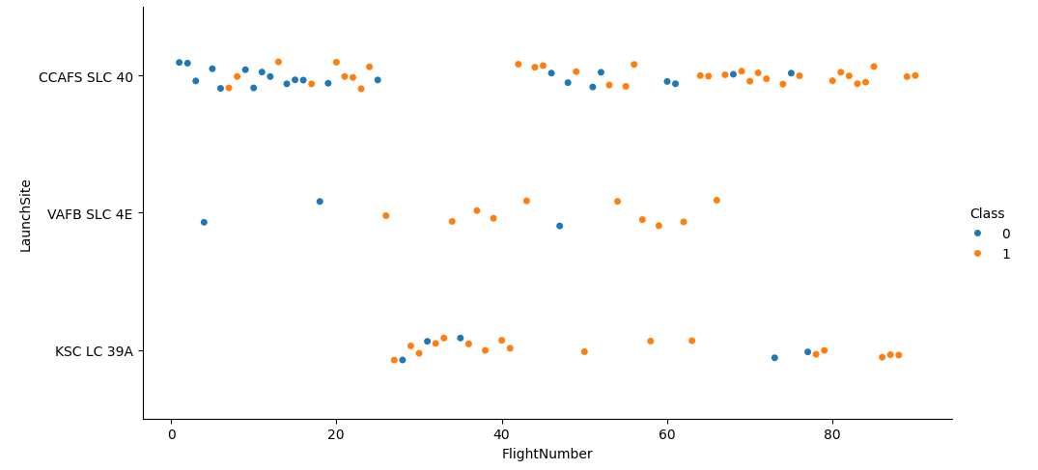
Flight Number vs. Launch Site
Landing success (Class=1) becomes more frequent in later flights across all sites.
CCAFS SLC 40 has the highest number of launches, so most successes are observed there.
KSC LC 39A shows mostly successful outcomes after it starts appearing in the dataset.

Slide 19
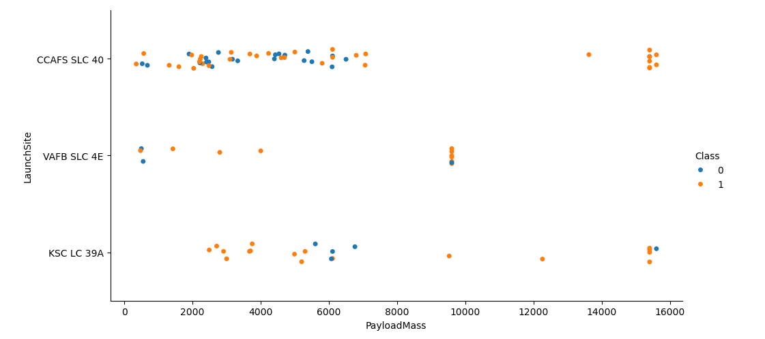
Payload vs. Launch Site
Successful landings occur across a wide payload range at CCAFS and KSC.
VAFB has fewer launches, but includes successful outcomes at mid payload masses.
Payload mass alone does not fully separate success/failure; launch site context matters.

Slide 20
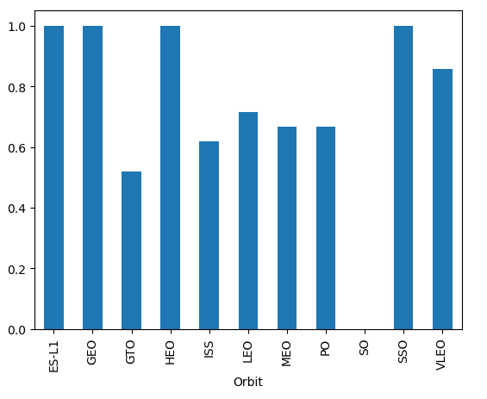
Success Rate vs. Orbit Type
Landing success rate varies by orbit type, indicating orbit is an important predictor.
Some orbits show consistently higher success rates than others.
This supports using Orbit as a key feature in the classification model.

Slide 21
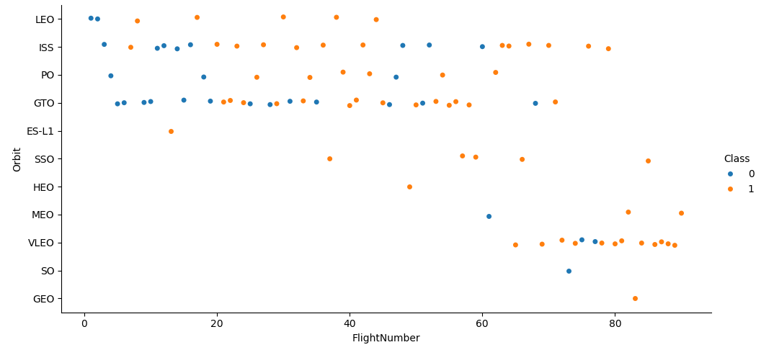
Flight Number vs. Orbit Type
Successful outcomes (Class=1) appear more frequently at higher flight numbers across multiple orbit types.
Certain orbits show a higher concentration of successes compared to others.
This suggests both mission experience (time) and orbit type influence landing success.

Slide 22
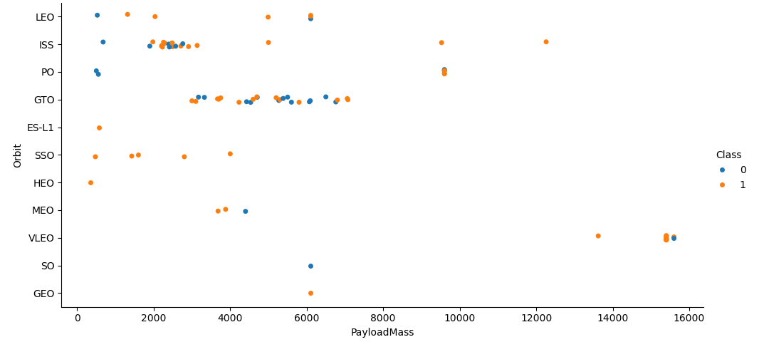
Payload vs. Orbit Type
Success patterns differ by orbit across payload ranges, showing an interaction between orbit and payload.
Some orbits achieve high success even at higher payload masses.
Payload mass alone is not sufficient; orbit type provides key separation for outcomes.

Slide 23
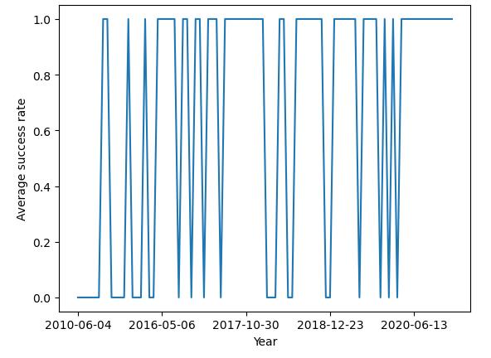
Launch Success Yearly Trend
Overall landing success improves over time, with a higher frequency of successes in later years.
Earlier years contain more failures, while later years show more consistent successful landings.
This indicates an operational learning effect over time.

Slide 24
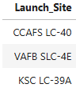
All Launch Site Names
Launch sites: CCAFS SLC 40, KSC LC 39A, VAFB SLC 4E.
This query lists all distinct launch site names in the dataset.
The output confirms the launch sites used for subsequent EDA and comparisons.

Slide 25
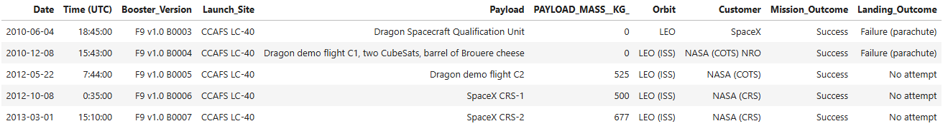
Launch Site Names Begin with 'CCA'
This query filters launch sites whose names begin with "CCA".
The result isolates CCAFS-related launches for focused analysis of that site group.

Slide 26
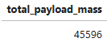
Total Payload Mass
This query calculates the total payload mass carried for NASA missions.
The result summarizes NASA’s contribution to the overall payload delivered in the dataset.

Slide 27
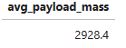
Average Payload Mass by F9 v1.1
This query computes the average payload mass for missions flown with Falcon 9 v1.1.
The output provides a baseline payload level for this rocket configuration.

Slide 28
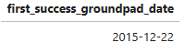
First Successful Ground Landing Date
This query identifies the first date when a successful ground landing occurred.
The result marks an important milestone in landing capability over time.

Slide 29
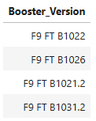
Successful Drone Ship Landing with Payload between 4000 and 6000
This query filters missions with successful drone ship landings and payload mass between 4000 and 6000.
The output highlights successful missions within this payload range.

Slide 30
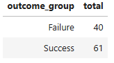
Total Number of Successful and Failure Mission Outcomes
This query counts the total number of successful and failed landing outcomes.
The result provides the overall class distribution used in model evaluation.

Slide 31
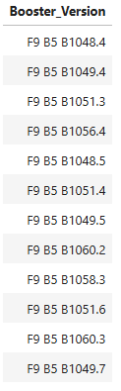
Boosters Carried Maximum Payload
This query identifies the booster(s) that carried the maximum payload mass in the dataset.
The output links the heaviest payload missions to their booster configuration.

Slide 32
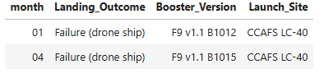
2015 Launch Records
This query retrieves 2015 launch records with a failed drone ship landing outcome.
The result lists the related booster and launch site details for those missions.

Slide 33
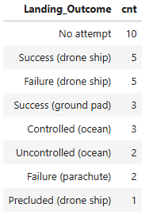
Rank Landing Outcomes Between 2010-06-04 and 2017-03-20
This query ranks landing outcomes between the specified dates using a window function.
The output helps compare missions within the selected time period by outcome and performance.

Slide 34

Section 3

Slide 35
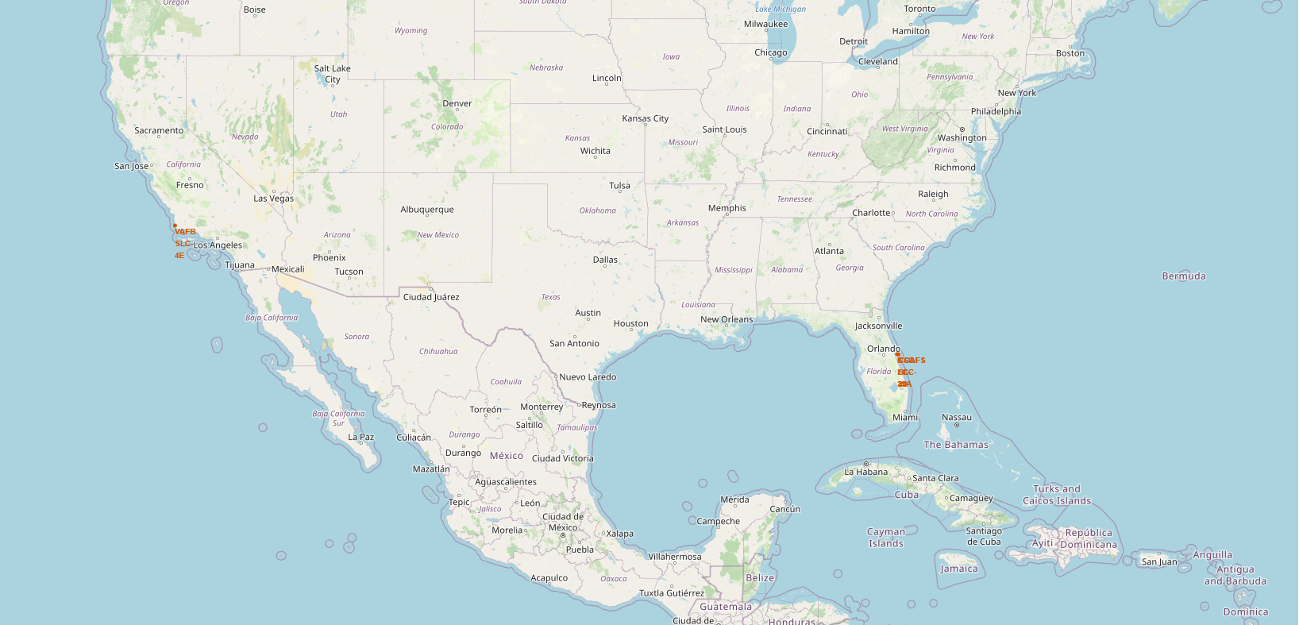
<Folium Map Screenshot 1>
This map shows the geographic locations of all Falcon 9 launch sites using Folium markers.
Each marker represents a launch site and provides location context for further analysis.

Slide 36
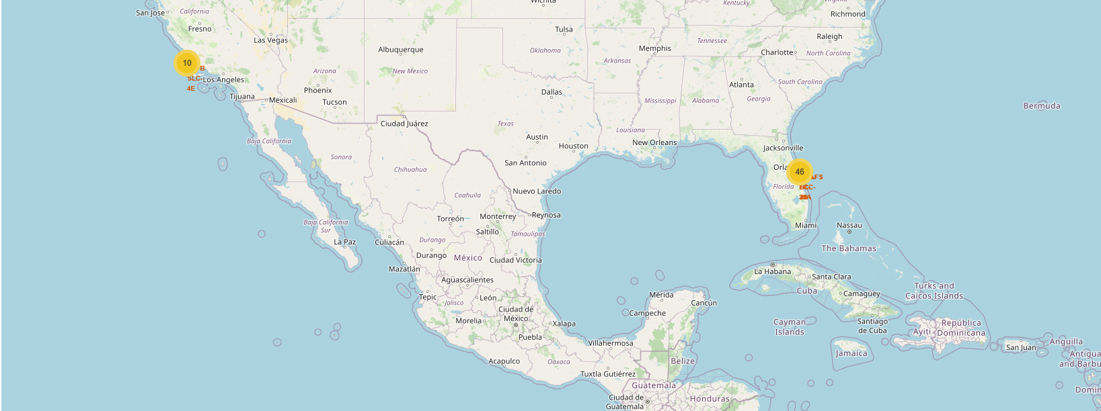
<Folium Map Screenshot 2>
This map visualizes landing outcomes by location (success vs failure) using colored markers.
It helps compare how outcomes are distributed across different launch sites.

Slide 37
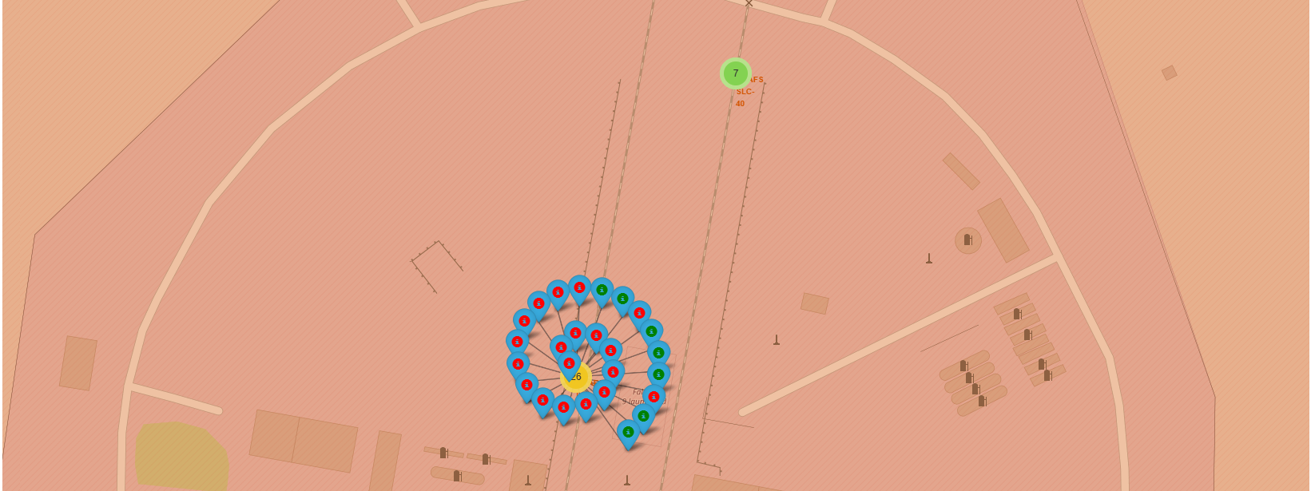
<Folium Map Screenshot 3>
This map performs a proximity analysis around a selected launch site (e.g., coastline, highway, railway).
Distances are visualized to provide geographic context for site selection and operations.

Slide 38

Section 4

Slide 39
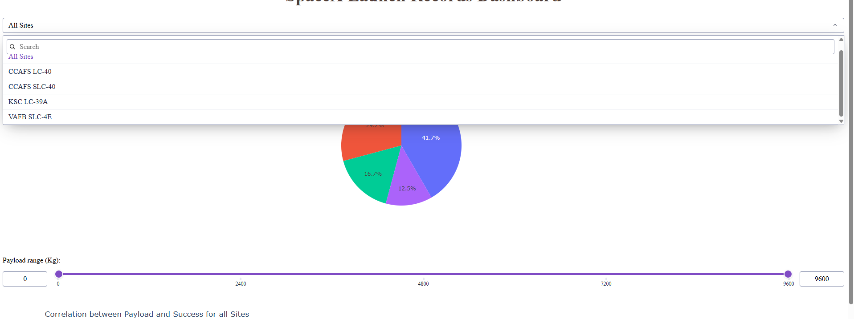
<Dashboard Screenshot 1>
This dashboard view shows the overall distribution of landing outcomes for all launch sites.
The pie chart summarizes total success vs failure counts across the entire dataset.

Slide 40
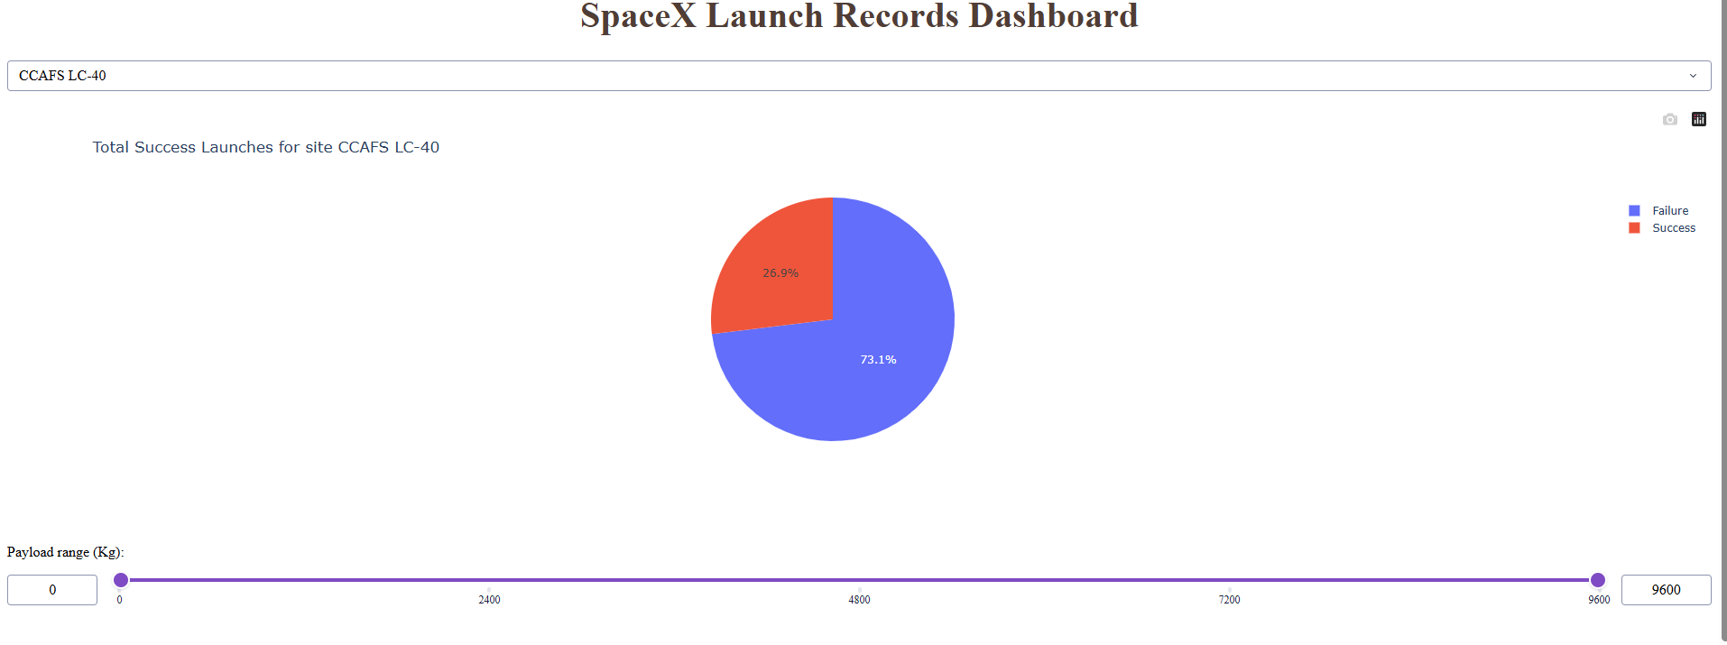
<Dashboard Screenshot 2>
This view filters the dashboard to a single launch site and displays its landing outcome distribution.
The pie chart enables quick comparison of success vs failure for the selected site.

Slide 41
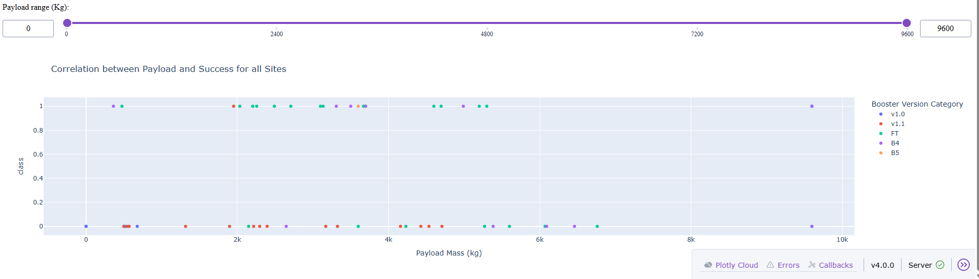
<Dashboard Screenshot 3>
The scatter plot shows the relationship between payload mass and landing outcome (Class) for the selected site(s).
Adjusting the payload range slider updates the plot to focus on specific payload intervals and compare success patterns.

Slide 42

Section 5

Slide 43
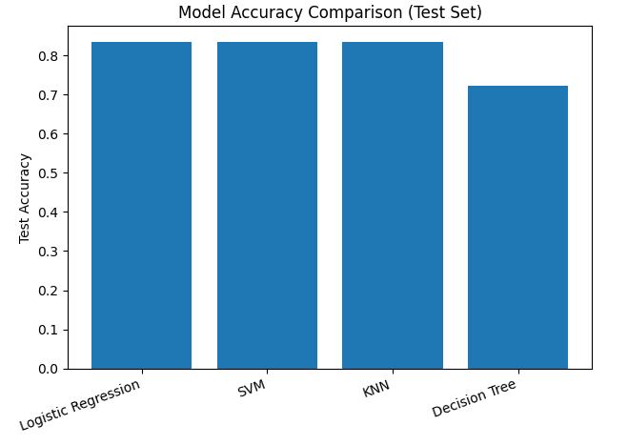
Classification Accuracy
Compared tuned classifiers (Logistic Regression, SVM, Decision Tree, KNN) using test accuracy.
All models achieved the same performance on the test set (Test Accuracy = 0.83).

Slide 44
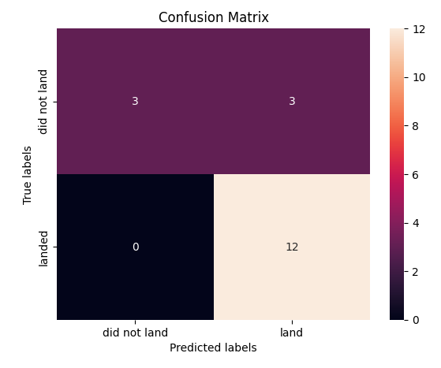
Confusion Matrix
Confusion matrix for the selected classifier on the test set.
Most errors are false positives, where a non-landing is predicted as a landing.

Slide 45
Conclusions
Landing success increases in later flights, indicating a clear improvement over time.
Success rate differs across orbit types, so Orbit is an important predictive feature.
Interactive Folium maps and the Dash dashboard support quick exploration by site and payload range.
Classification models achieved ~0.83 test accuracy, and the confusion matrix shows remaining errors are mainly false positives.

Slide 46
Appendix
SpaceX API Calls:
https://github.com/tcdn7/17-IBM-Test-Repo/blob/main/1-jupyter-labs-spacex-data-collection-api.ipynb
Web Scraping:
https://github.com/tcdn7/17-IBM-Test-Repo/blob/main/2-jupyter-labs-webscraping.ipynb
Data Wrangling:
https://github.com/tcdn7/17-IBM-Test-Repo/blob/main/3-labs-jupyter-spacex-Data%20wrangling.ipynb
EDA with SQL:
https://github.com/tcdn7/17-IBM-Test-Repo/blob/main/4-jupyter-labs-eda-sql-coursera_sqllite.ipynb
EDA Visualization:
https://github.com/tcdn7/17-IBM-Test-Repo/blob/main/5-edadataviz.ipynb
Folium Map:
https://github.com/tcdn7/17-IBM-Test-Repo/blob/main/6-lab_jupyter_launch_site_location.ipynb
Machine Learning Prediction:
https://github.com/tcdn7/17-IBM-Test-Repo/blob/main/7-SpaceX_Machine%20Learning%20Prediction_Part_5.ipynb
Plotly Dash App:
https://github.com/tcdn7/17-IBM-Test-Repo/blob/main/spacex-dash-app.py

Slide 47


